Slide 1
Irish Car Stock Model V 2
Absorptive Capacity Building Workshop
Presenter : Vera O’Riordan
Role: PhD Student
Institution : Energy Policy & Modelling Group, MaREI, UCC

Slide 2
Topics
01
What the model can & can’t do
02
Overview of the model & navigation
03
Adding a year
04
Creating a new scenario

Slide 3
Topics
01
What the model can & can’t do
02
Overview of the model & navigation
03
Adding a year
04
Creating a new scenario

Slide 4
Outputs
Stock – number of cars in each technology
Mileage (kilometres)
Energy Consumption (MJ)
Carbon Dioxide Emissions (tCO2)

Slide 5
What it can do
Project emissions for improved biofuel mixing rates
Project emissions for increased/decreased EV sales
Project emissions reductions for reduced activity scenarios
Project car stock based on historical legacy of the stock
Project increases in car sales based on economic activity
Project impacts of fuel type bans & transitions
Project impact of improved efficiencies

Slide 6
What it can’t do
Model future changes in consumer habits
Model impact of second hand imports – only bases imports from historical survival rates
Take a deeper look into consumer behaviour and what drives emissions – only what emissions would look like under a set of rules

Slide 7
Insights, not answers

Slide 8
Topics
01
What the model can & can’t do
02
Overview of the model & navigation
03
Creating a new scenario
04
Adding a year

Slide 9
Navigation
Readme – cover sheet with colour coding, update if changes made, document scenarios here.
References – links
“…. Display” – results output for each scenario
Input sheets

Slide 10
BaU scenario sheet
Sales + Sales percentages
References to ‘Drivers’ sheet

Slide 11
Stock
Total Stock = New sales + Old stock*survival rate
2018, vintage 0 * survival rate (fuel type) = 2019 vintage 1
Demo: BaU Stock

Slide 12
Mileage
Assumption : 0.02% decline in mileage as a car ages 1 year
Demo: BaU Mileage
Source for average mileage of a given car technology: NCT!

Slide 13
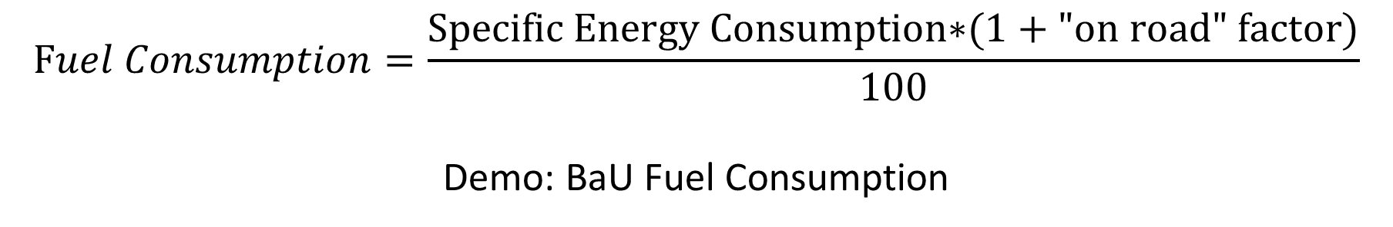
Fuel Consumption
$$Fuel Consumption=\frac{\text{S}\text{pecific} \text{Energy} \text{Consumption}\text{∗(1 + }\text{"}\text{on} \text{road}\text{"} \text{factor}\text{)}}{100}$$
Demo: BaU Fuel Consumption

Slide 14
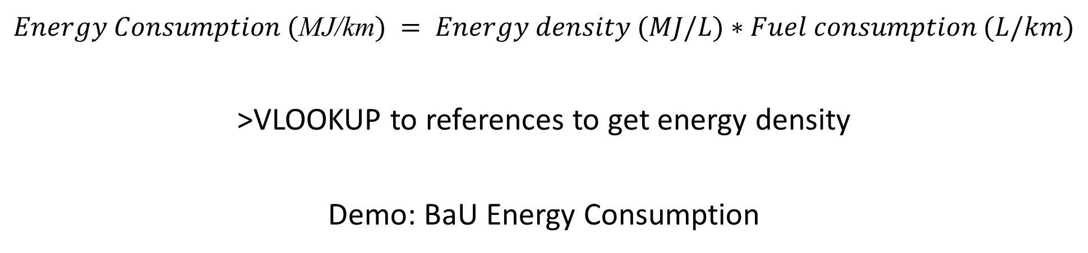
Energy Consumption
$Energy Consumption ($MJ/km$) = Energy density (MJ/L)∗Fuel consumption (L/km)$
>VLOOKUP to references to get energy density
Demo: BaU Energy Consumption

Slide 15
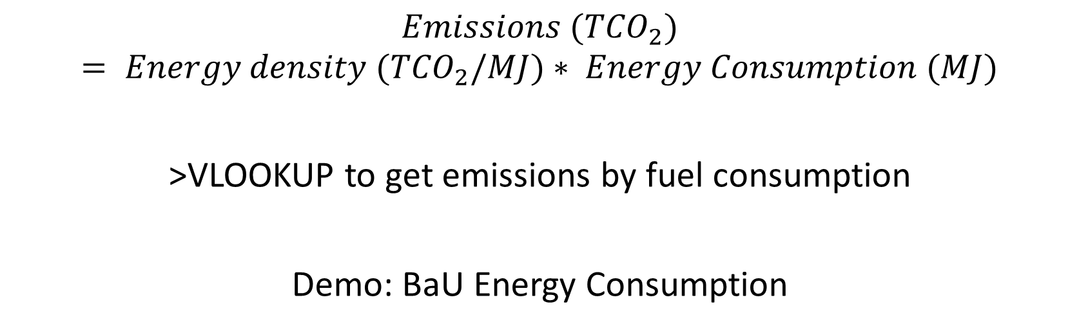
Emissions
$$Emissions ({TCO}_{2})= Energy density ({TCO}_{2}/MJ)∗ Energy Consumption (MJ)$$
>VLOOKUP to get emissions by fuel consumption
Demo: BaU Energy Consumption

Slide 16
BaU
Future projections to 2050
>Historic worksheet
>Summary worksheet
Demo: BaU Scenario

Slide 17
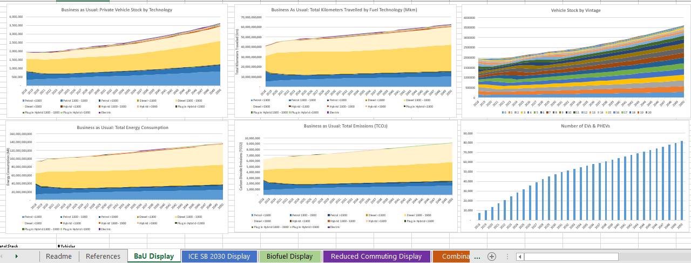
Results are shown in BaU Display worksheet
Demo: BaU Display
Scroll in the worksheet for the numerical references to the figures

Slide 18
Topics
01
What the model can & can’t do
02
Overview of the model & navigation
03
Adding a year
04
Creating a new scenario

Slide 19
Tips
Information needed:
New sales for that year
Specific Energy Consumption by fuel technology
On-road factors
Mileage by technology
Number of new sales
Add in row year
Copy method for 2018

Slide 20
Stock
New sales + Old stock*survival rate

Slide 21
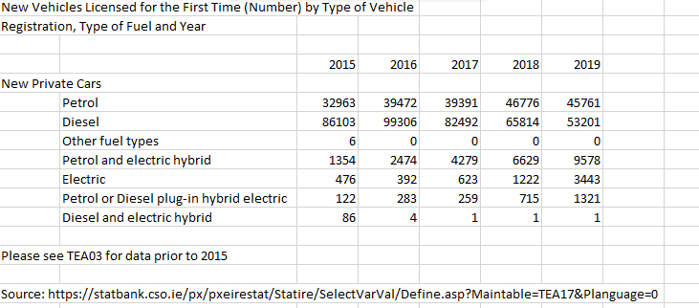

Slide 22
Add new year block in “Stock” sheet
New sales = vintage 0
Update older vintage using survival rate from “Survival Rate” sheet
2018, vintage 0 * survival rate (fuel type) = 2019 vintage 1

Slide 23
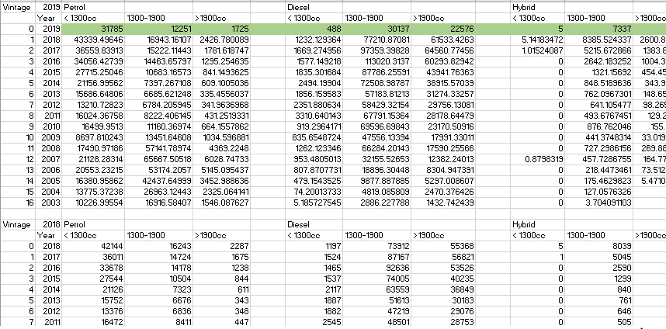
CSO figures/SEAI gather information on cars by engine cc
2019, vintage 1, petrol = 2018, vintage 0, petrol* “Survival Profiles, vintage 1, petrol
CSO figures/SEAI gather information on cars by engine cc

Slide 24
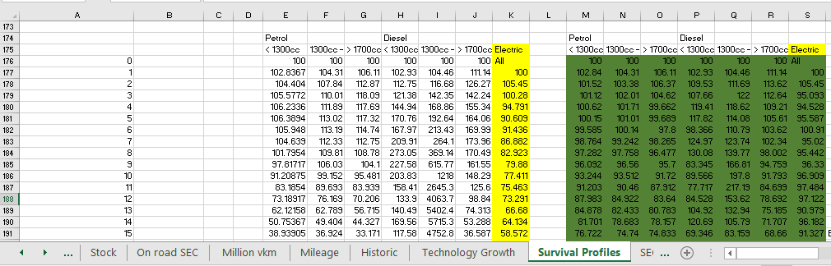

Slide 25
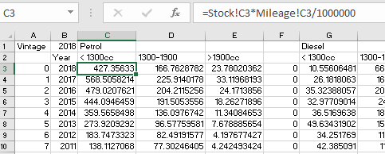
Million vkm = Stock*Average mileage(km)/1000000

Slide 26
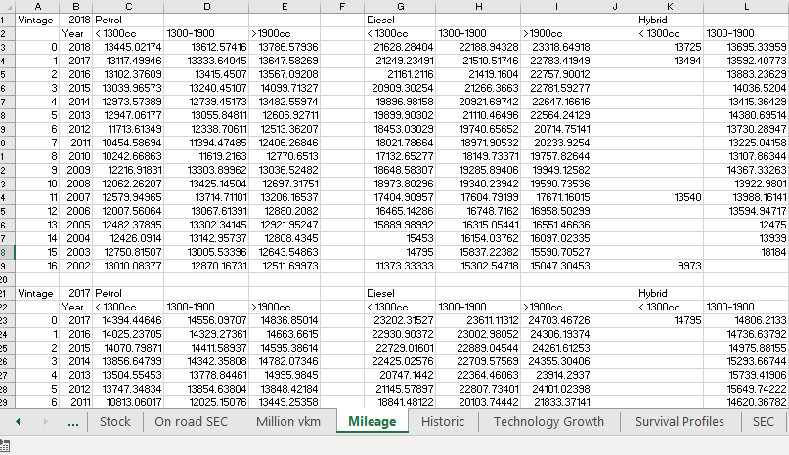
Mileage – average mileage of a car of a particular fuel type and engine cc, based on information from the NCT.

Slide 27
Update Mkm > update mileage (CSO or just use 2018 figures)
Figures are from NCT – they can give you mileage by engine cc
Copy and paste and add in new year above
Sales sheet – update sales

Slide 28
Once you’ve updated
Stock
Mileage
Million vkm
You can update the ‘historic’ worksheet

Slide 29
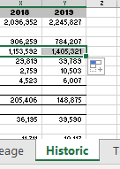
Click and drag horizontally to update

Slide 30
On road SEC – add in new year
Figures from UK GOV
On road factors*SEC = On road SEC
WLTP updates should replace need for on-road factor
l/100km
kWh/100km for electric cars!

Slide 31
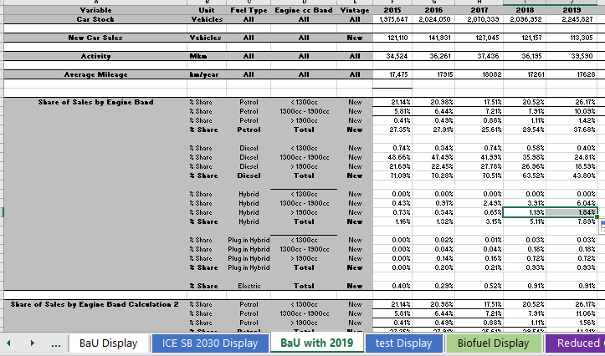
Now that you’ve added a new year to the historic sheet, you can update the BaU scenario

Slide 32
Topics
01
What the model can & can’t do
02
Overview of the model & navigation
03
Adding a year
04
Creating a new scenario

Slide 33
How-to
Create separate sheets for summary, stock, mileage, fuel consumption, energy consumption & emissions “new scenario”
Adjust values as you see fit!
Create copy of other scenario display and calculate stock, total mileage, total energy consumption, emissions, stock by vintage using formula developed in other Display sheets, routing to the new scenario sheets

Slide 34
Ideas
Adjusting sales proportions
Adjusting future biofuel proportions
Adjusting future fuel consumption
Adjusting future mileages (total mileage) – remote working example
Adjusting sales to hit targets (CAP Target)

Slide 35
Examples: Biofuel scenario
> Updated ‘emissions’ section to reflect reduced emissions from biofuels

Slide 36
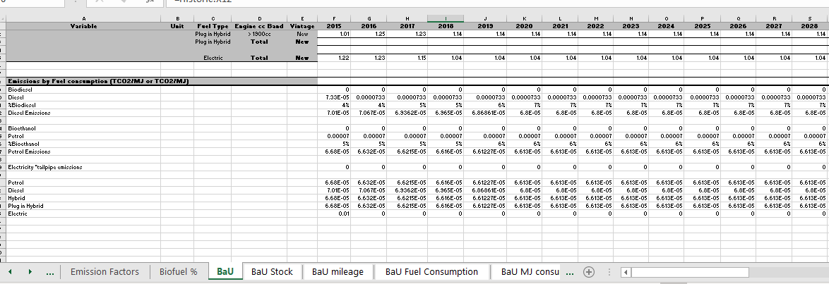
BaU Scenario

Slide 37
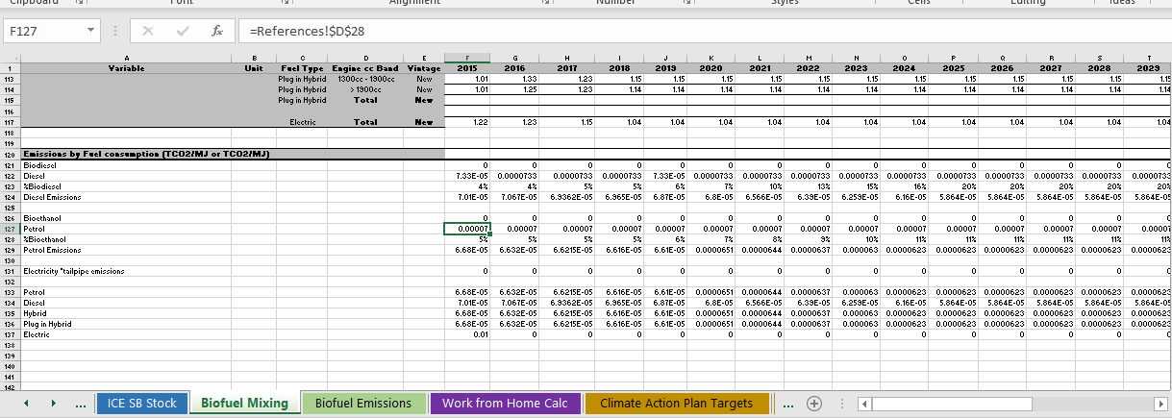
Biofuel mixing Scenario

Slide 38
Comparison

Slide 39
Question for the team:
Version control:
Lets say one of the team makes a change – adding a new scenario – to the model, so now there’s an Irish Car Stock Model V 2.2. How do we make sure the rest of the team has access to the change and there is no confusion with version numbers and new additions?

Slide 40
Keep centralised folder with all versions in one place.
When change is made update version number

Slide 41
Using the Irish Car Stock Model for a report or publication?
Be sure to mention the Energy Policy and Modelling Group in MaREI!
Currently working on the carbon emissions savings potential of walking/cycling as modes of transport for short journeys and an interactive tool on policy pathways for CO2 emissions reduction … watch this space!

Slide 42
Thank you for your time
Vera O’Riordan – PhD student, Marine and Renewable Energy Institute, UCC
vera.oriordan@ucc.ie

